Slide 1

Stroke Prediction
By: Bryan Pritsker

Slide 2

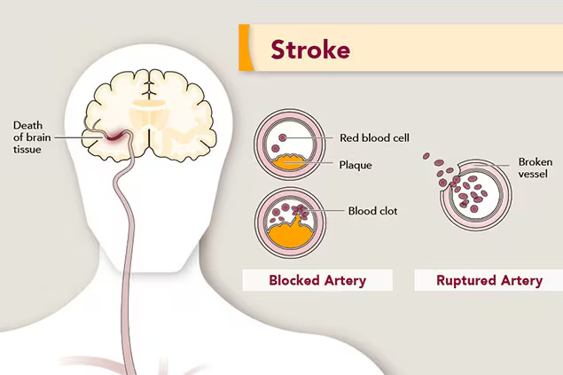
Background
Strokes are critical medical emergencies that arise when blood flow to the brain is blocked or when there is sudden bleeding in the brain.
There are several health conditions that could contribute to strokes, including diabetes, obesity, high blood pressure, and smoking.
The dataset for the project, obtained from the “Kaggle” website, contains medical info on over 5000 patients
The output column is the “stroke” column
0 = No Stroke, 1 = Stroke

Slide 3

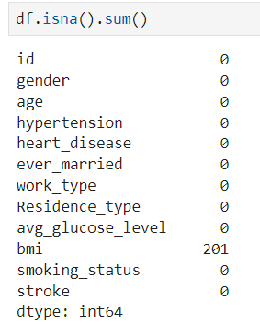
Data Preprocessing: Missing Values
The DataFrame has a total of 201 missing values in the “bmi” column
201 / 5110 missing values represents a significant portion that cannot be overlooked
The missing values are of the type “MCAR” (Missing Completely At Random)

Slide 4
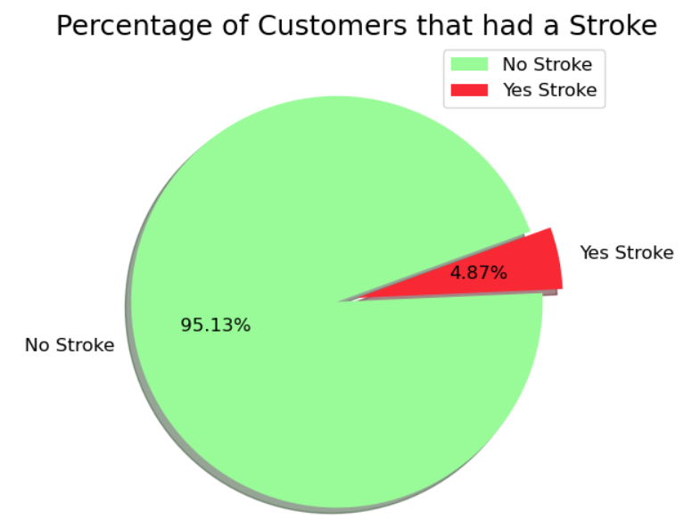
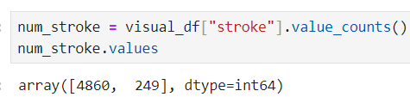
Data Visualization Revealing Imbalanced Data
Since the dataset is so highly imbalanced, we will need to use imbalanced data techniques before we can apply machine learning prediction models later in the project

Slide 5


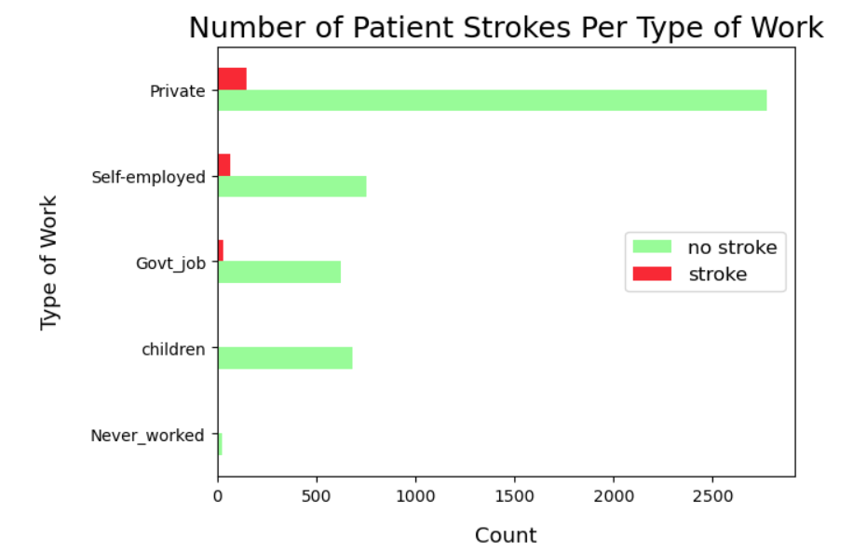
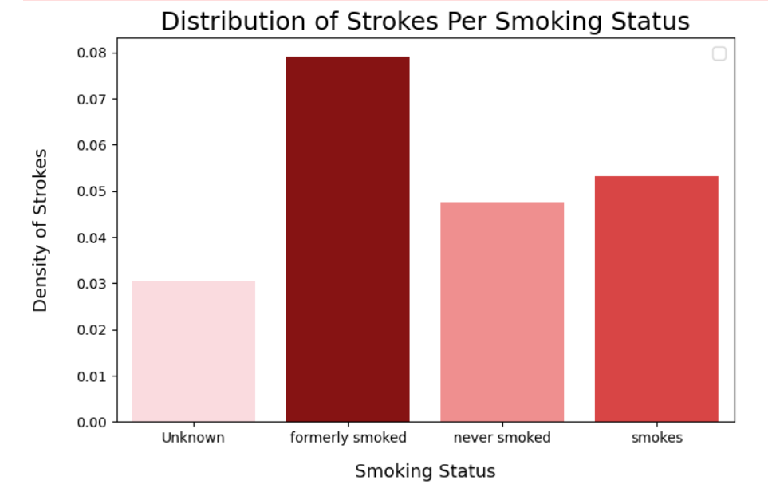
Data Visualization: Connections with the Output Column
Patient work types do not have much of a correlation with strokes
While smoking status absolutely increases the density of patients who experienced a stroke

Slide 6
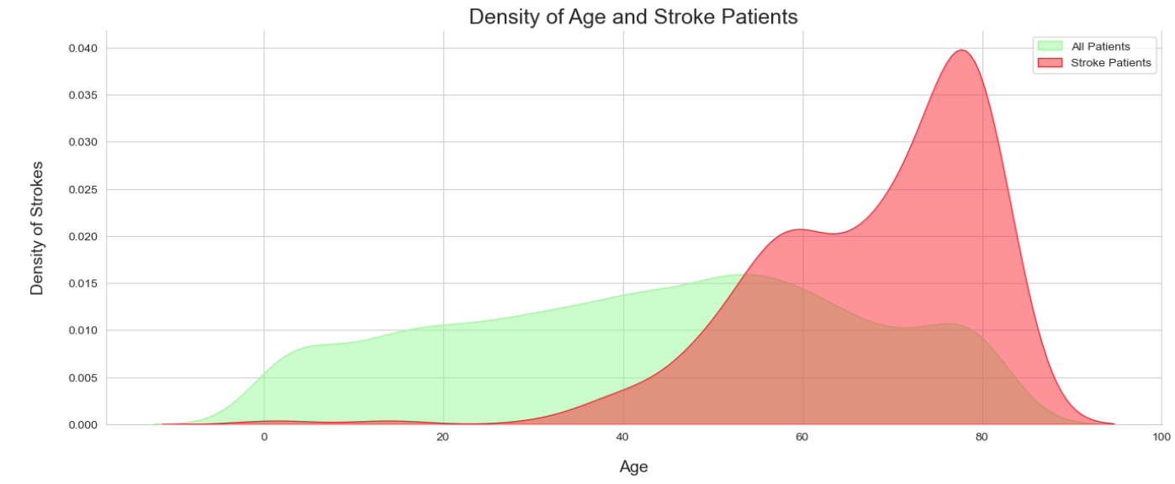

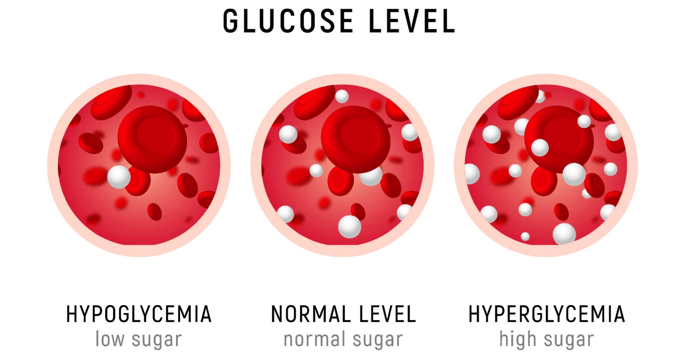
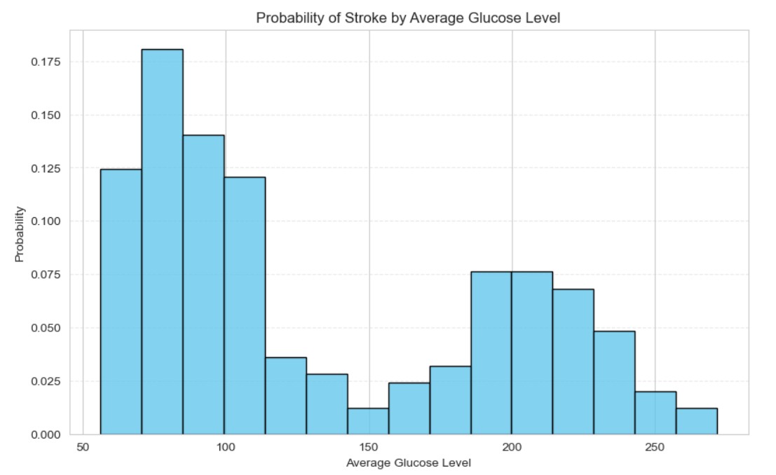
Data Visualization: Two Key Features
The features: “Average Glucose Level” and “Age” are highly correlated with Stroke Incidences

Slide 7
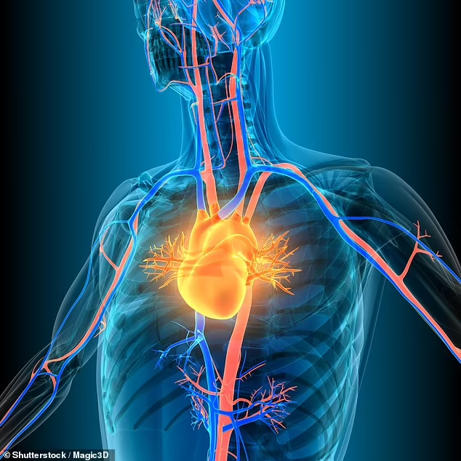
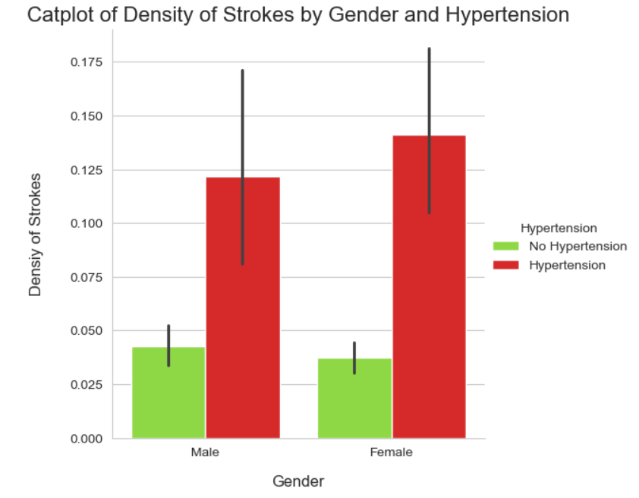
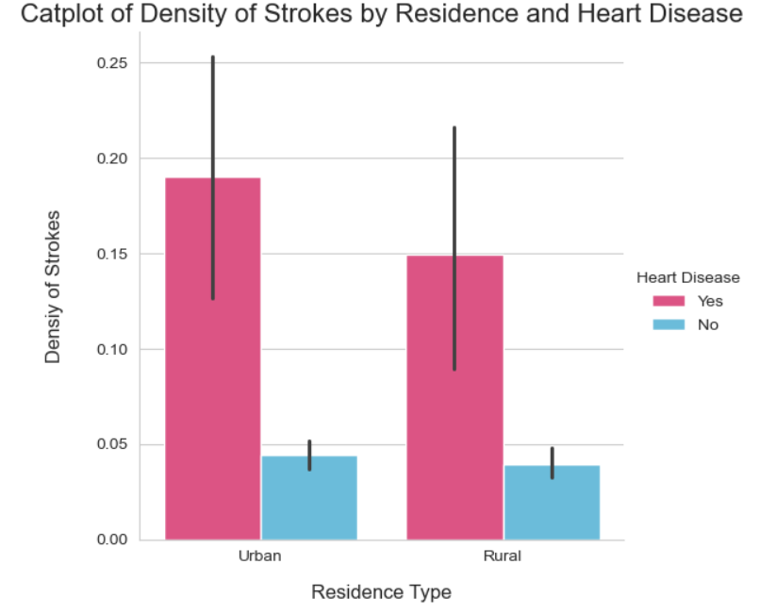
What if we Consider Combinations of Features?

Slide 8
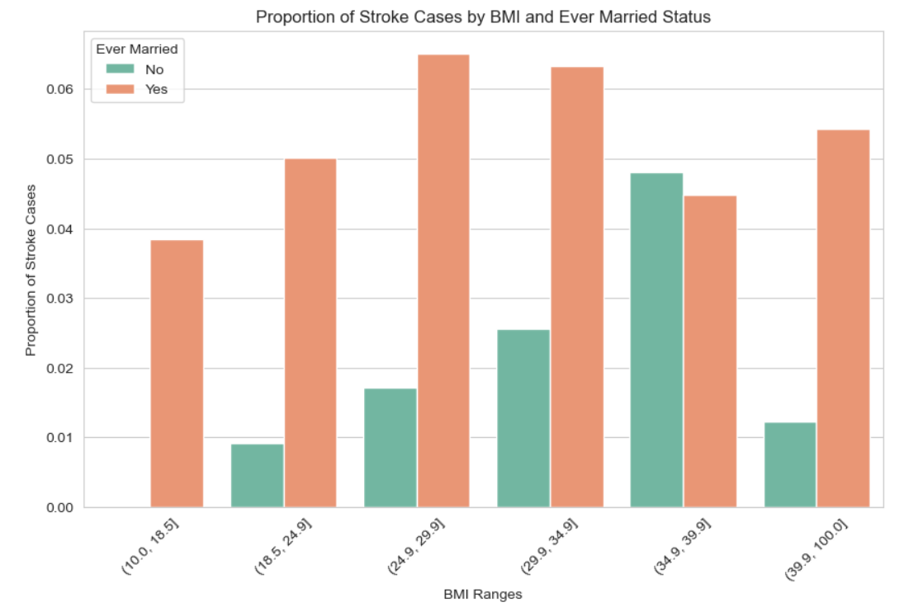
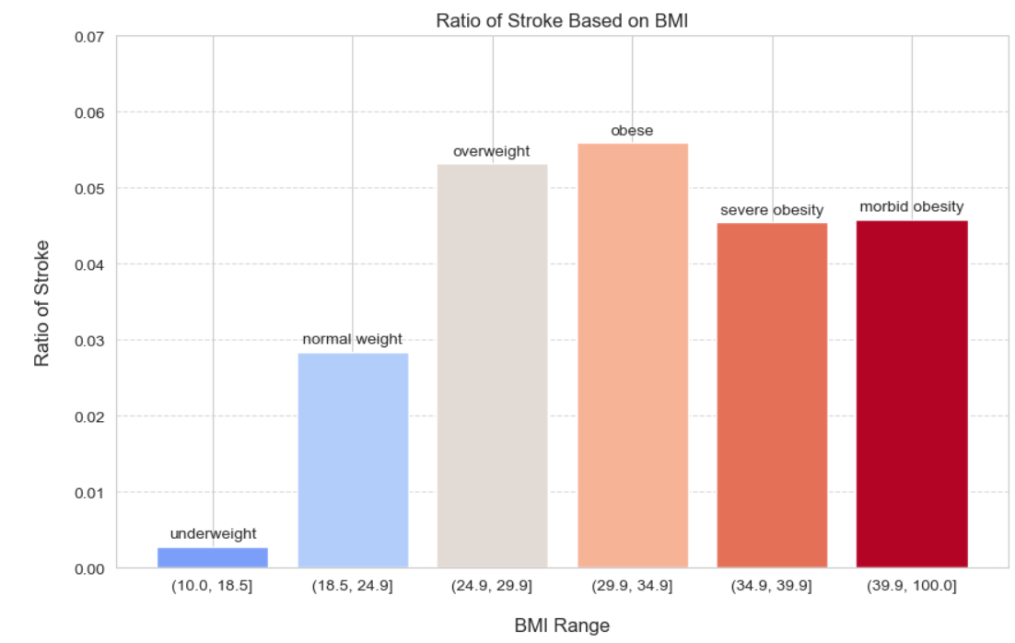
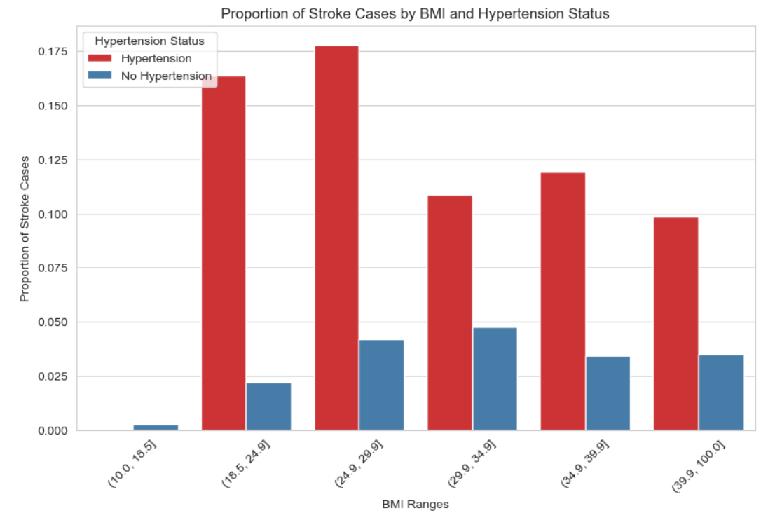
Key Findings on “BMI” Feature

Slide 9

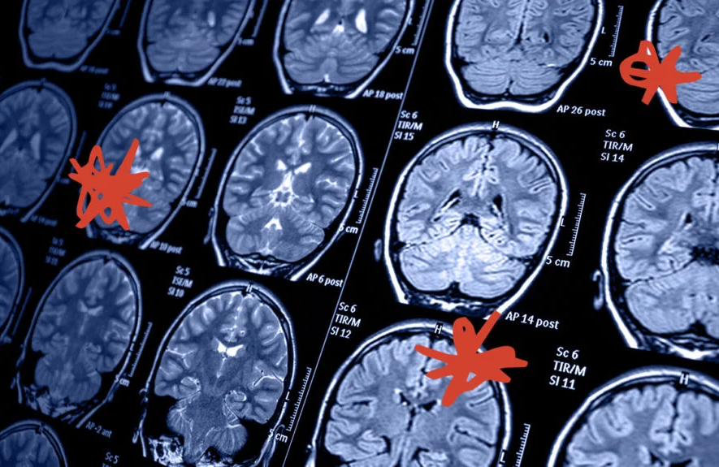
Key Results of Data Visualization
Certain input features like: “age”, “avg glucose level’, and “hypertension” are correlated with stroke incidences
Specific input features in the DataFrame have strong correlations with one another (especially with the “BMI” column)
The underlying connections between input features stress the use of the “wrapper method” during feature selection
Impute missing data in the “bmi” column using linear regression

Slide 10

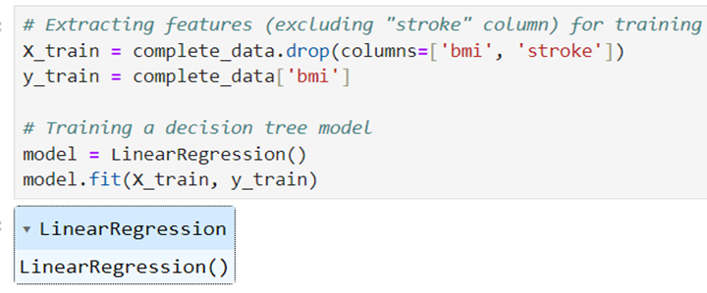
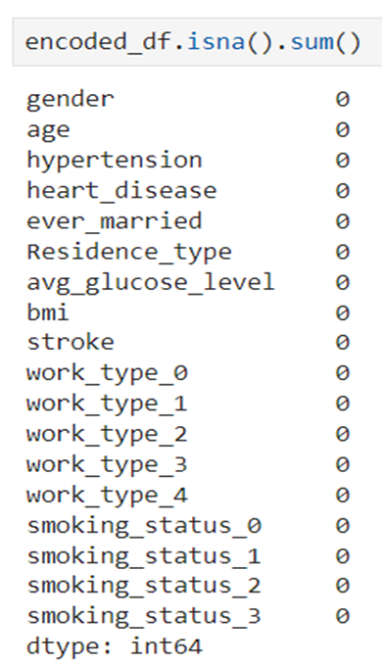
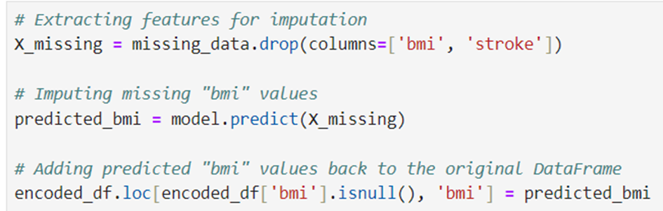
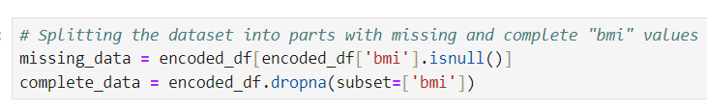
Using Linear Regression to Replace Missing “BMI” Values
Split the dataset into two parts: rows with missing “bmi” values, rows with “complete” data
Make sure X_train and y_train do NOT contain the “stroke” feature. We do not want data leakage with the output column
Fit X_train and y_train to the linear regression model
Plug the missing rows, excluding the stroke_column, into the linear regression model (the model will compute continuous values for the “bmi” data)
Add the predicted values back to the original DataFrame in replacement of the missing “bmi” values

Slide 11
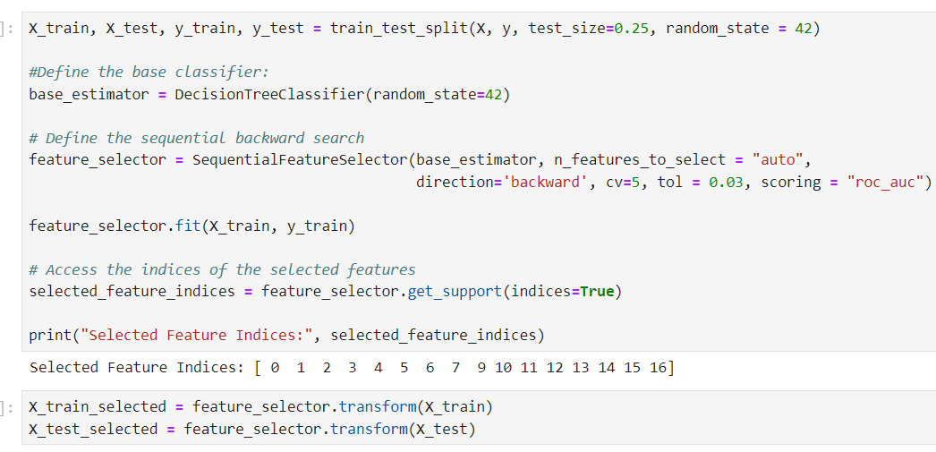
Feature Selection: Wrapper Method
Note: We used Roc AUC scoring over regular model accuracy because:
ROC curve is designed to evaluate how efficiently the model is performing.
The higher the Roc AUC score, the better the model is at distinguishing between the positive (majority) and negative (minority) classes
It is an extremely useful metric when the data is imbalanced.
In our case, the wrapper method dropped one column: “work_type_0” (index 8)
Feature selection is very useful for logistic regression models because it reduces the dimensionality of the dataset.
This will simplify the model, making it easier to interpret, faster to execute, and less prone to data biases
Feature Selection Technique: Wrapper Method (sequential backward elimination)
1. Our Sequential backward elimination process:
2. Fit all the features to a Decision Tree model
3. Calculate the performance of these features based on the “Roc AUC” score (with tol = 0.03)
4. Greedily remove the least relevant features (one at a time) that does not improve the performance of the algorithm.
5. Process stops once removing any extra feature would cause the Roc AUC score to drop by 0.03.

Slide 12
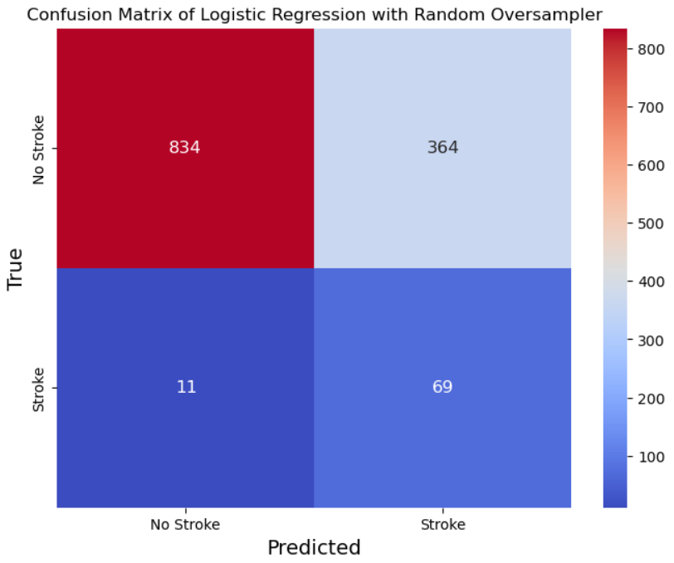
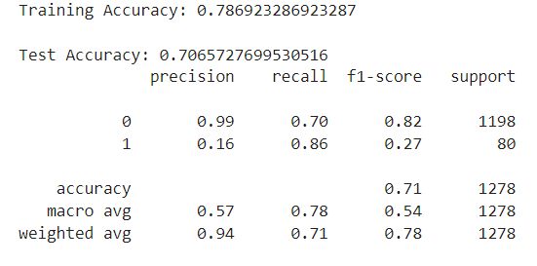
Logistic Regression Model Results
Our Logistic Regression Model utilized:
Feature Selection to drop the column: work_type_0
Random Oversampler
Weight = 1.4 applied to the minority stroke class

Slide 13
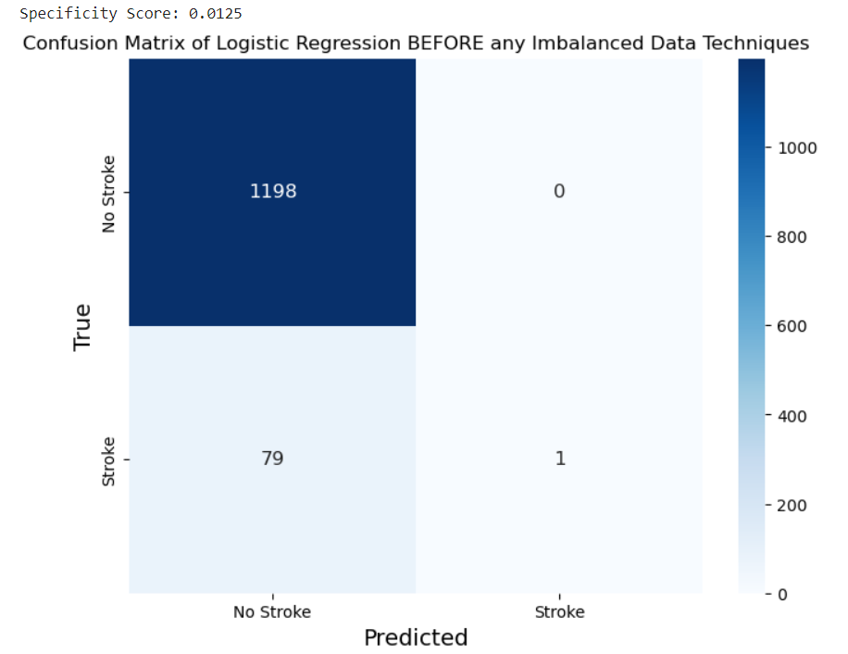
Logistic Regression Model Comparisons
LR Model Before any Imbalanced Data Techniques
LR Model with Feature Selection, Random Oversampler, and Weight = 1.4 applied to Stroke Class

Slide 14
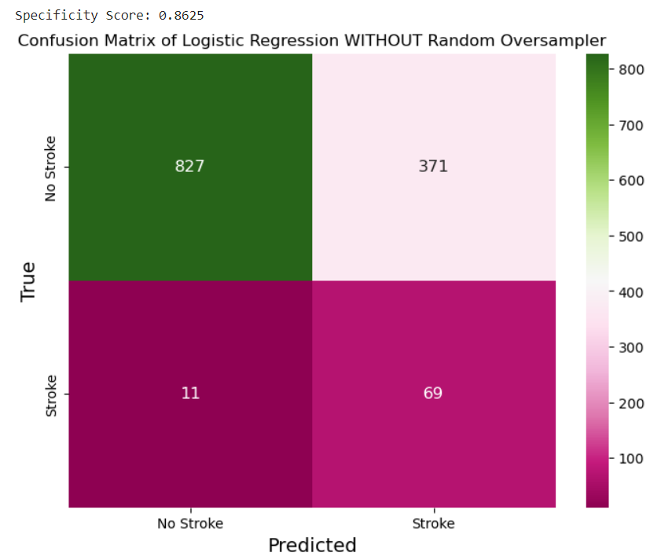
Logistic Regression Robustness (Part 1)
LR Model WITHOUT Random Oversampling and weight = 32 applied to Stroke Class
LR Model with Random Oversampling and Weight = 1.4 applied to Stroke Class

Slide 15
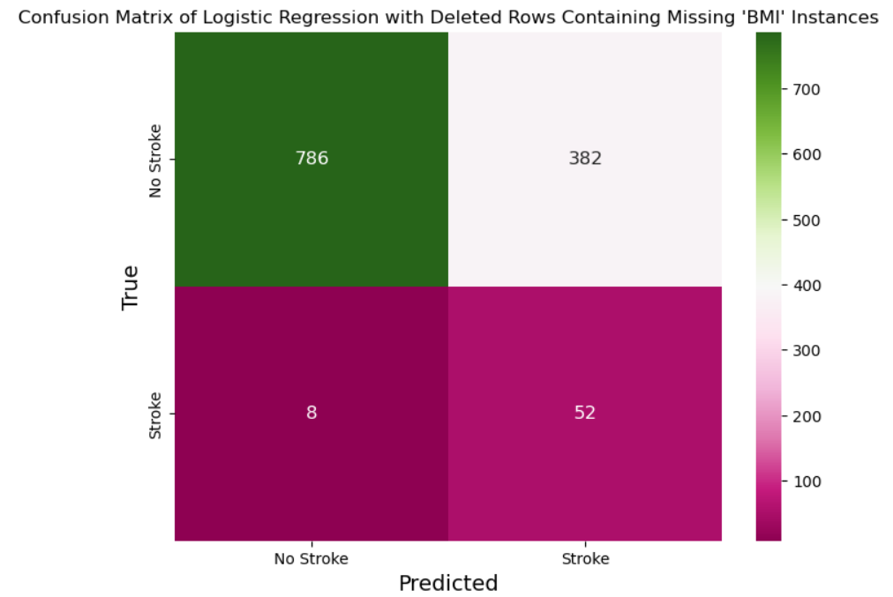
Logistic Regression Robustness (Part 2)
LR Model With Deleted Rows of Missing “BMI” Values
LR Model with Imputed Rows of Missing “BMI” Values (using Linear Regression)

Slide 16
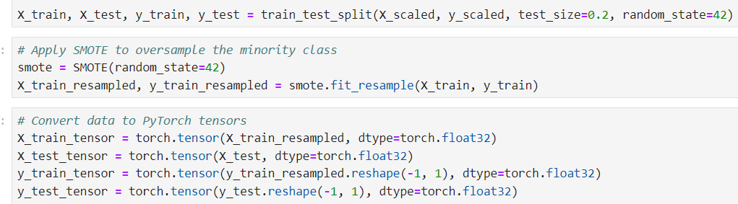
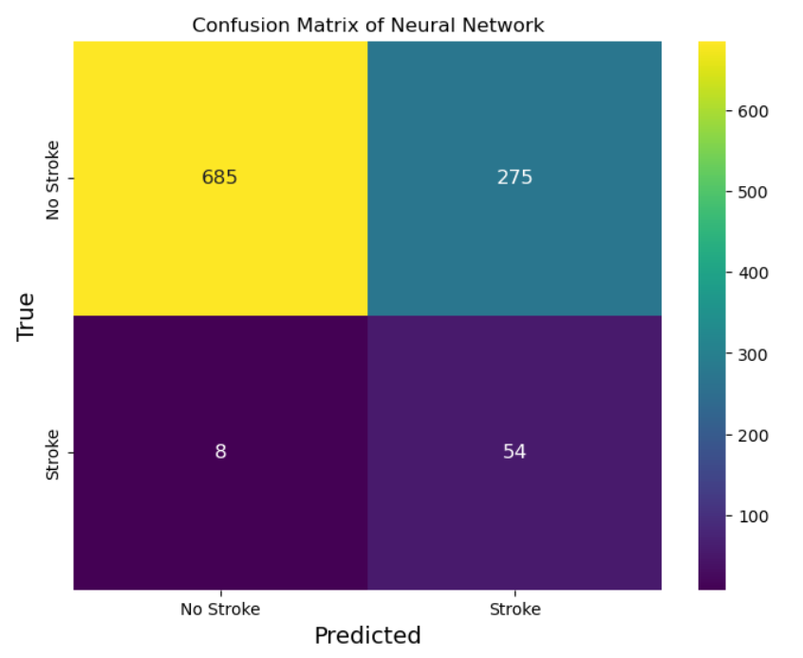
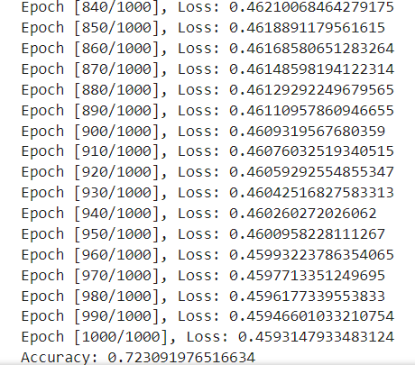
Neural Network
Our Neural Network Model was created using PyTorch
We applied SMOTE instead of Random Oversampling to balance the Training Data
The network had 10 neurons in the first layer and 5 neurons in the second.
First hidden layer used the ReLU activation function
Second hidden layer used the sigmoid activation function.

Slide 17

Conclusion
EDA highlighted important correlations between input features
Imputation of the missing data using Linear Regression improved both classification models’ results
The Logistic Regression Model with random oversampling was a robust model, and even slightly outperformed the model that did not use random oversampling
The Neural Network with SMOTE was the best performing model, improving in all metrics in comparison with the Logistic Regression Model
Our project achieved promising results in identifying potential stroke cases while addressing imbalanced data challenges

